Slide 1
Fuzzy Matching Strategy

Slide 2
Fuzzy Matching Strategy
GOAL:
Classify words from OCR into categories:
{medicinal ingredients, non-medicinal, claim, npn, company name, product name, …}
… but first, we need some QA steps to ensure the fidelity of words extracted via OCR.

Slide 3
Build Master Vocabulary
NHP Online Data
Master word level vocabulary
NHP Product purpose
NHP Products (names)
NHP Product risk
NHP Medicinal ingredients
NHP Non-medicinal ingredients
NHP Companies (names, addresses)
NHP Recommended Dosage
Med. Ingredient: word level vocabulary
.
.
.
Product name: word level vocabulary

Slide 4
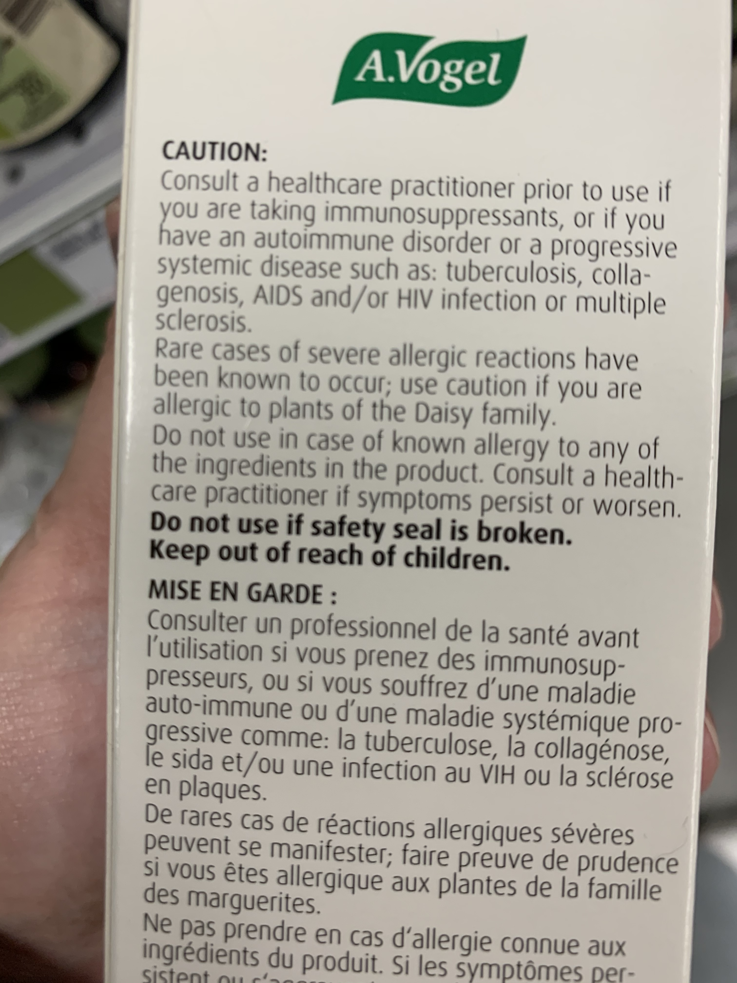
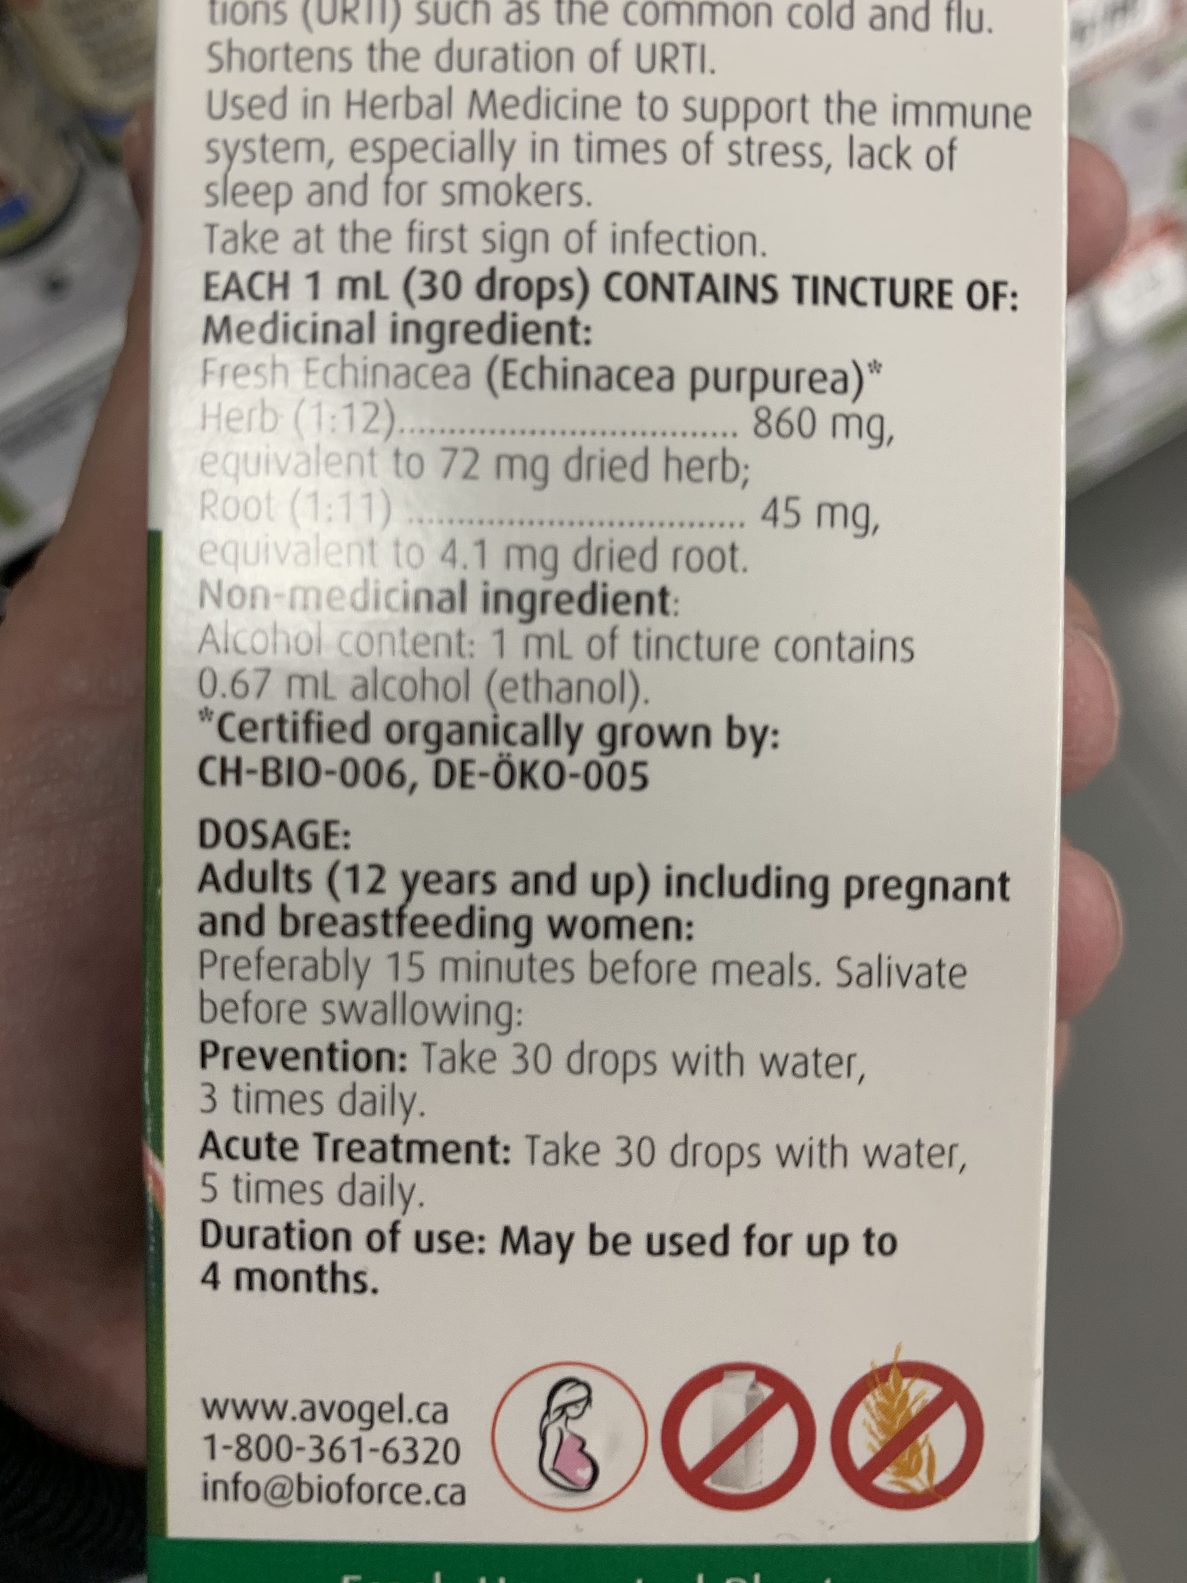
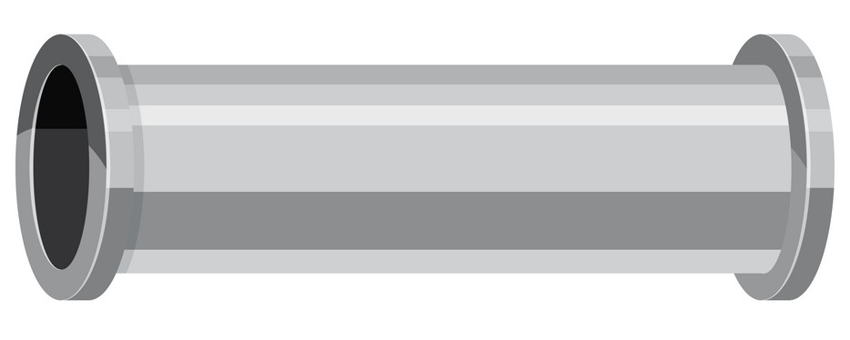
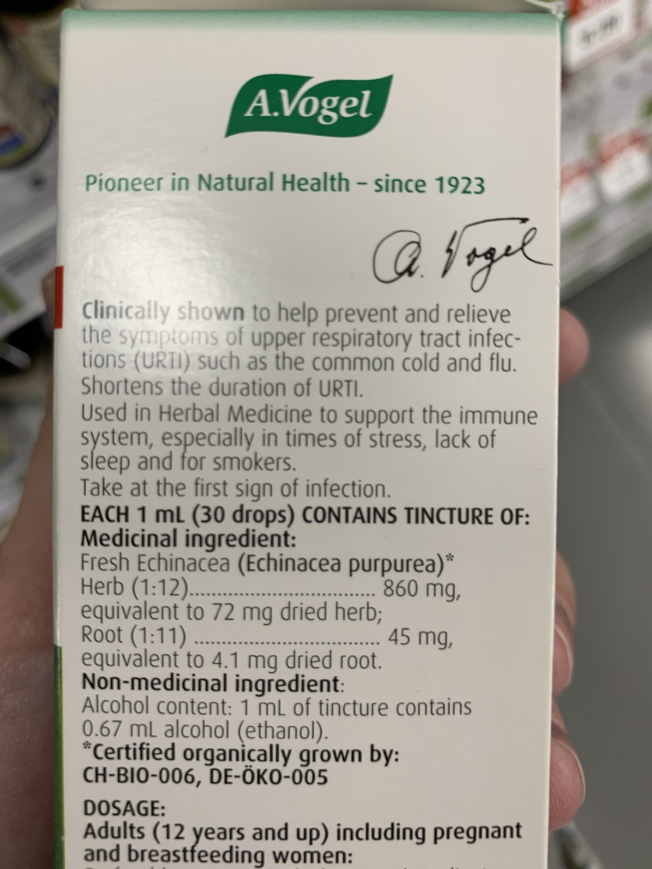
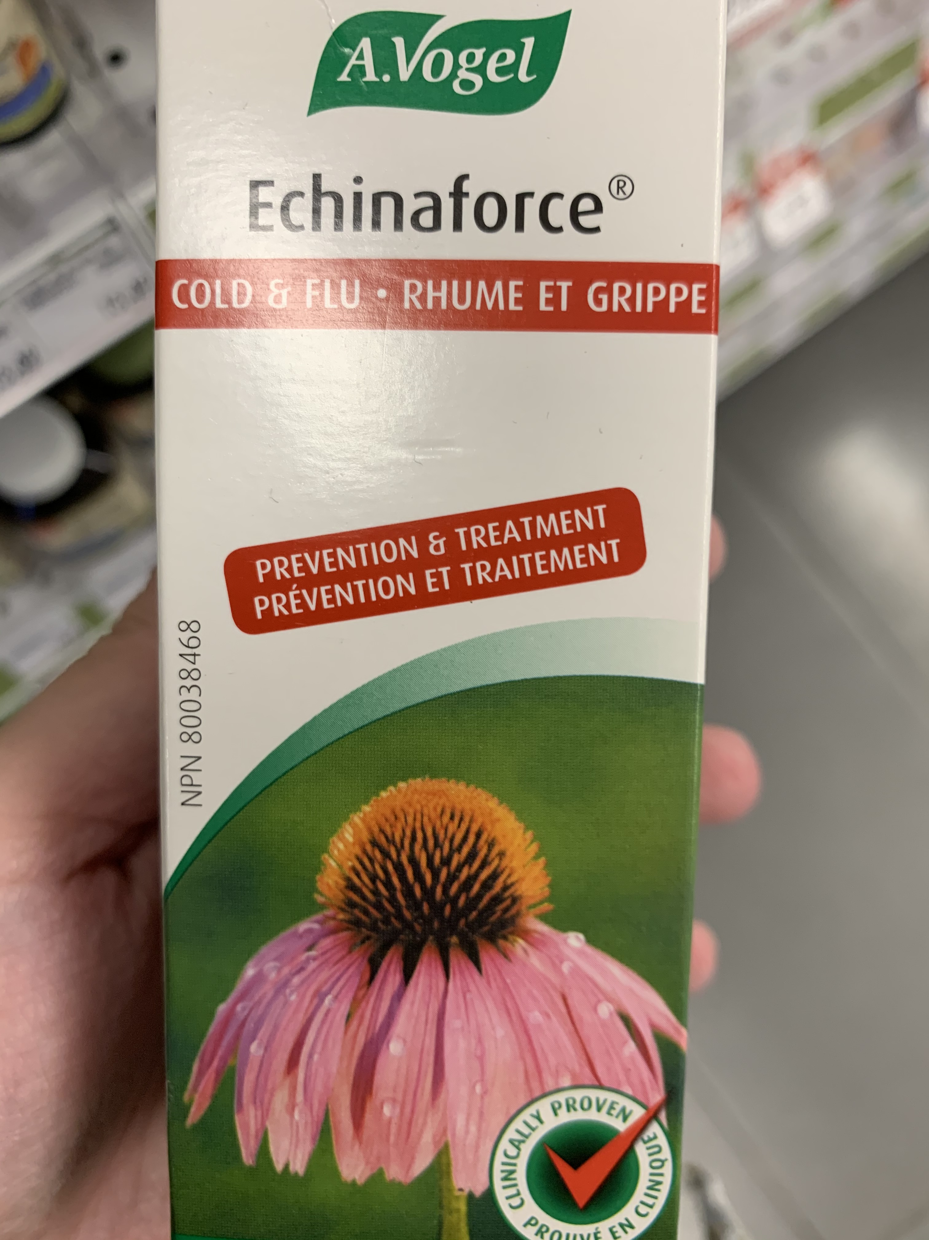
Pre Word Classification Pipeline
{"all_text":
["avogel", "-chinaforce", "cold", "flu", "a", "rhume", "et", "grippe", "treatment", "co", "prevention", "traitement", "et", "prevention", "80038468", "npn", "prove,", "clinically", "cliniqu<", "promet", "en"],
"phrase": [
{"text": "avogel", "all_x": ["1108.8", "1764.0", "1764.0", "1108.8"], "all_y": ["100.8", "100.8", "315.0", "315.0"]},
{"text": "-chinaforce", "all_x": ["807.25366", "1980.0122", "1977.4232", "804.6647"], "all_y": ["545.7102", "559.6716", "777.1408", "763.1794"]},
{"text": "cold", "all_x": ["548.1", "825.3", "825.3", "548.1"], "all_y": ["894.6", "894.6", "1014.3", "1014.3"]},
{"text": "flu", "all_x": ["989.1", "1178.1", "1178.1", "989.1"], "all_y": ["894.6", "894.6", "1014.3", "1014.3"]},
{"text": "rhume", "all_x": ["1304.1", "1713.6", "1713.6", "1304.1"], "all_y": ["900.9", ……..
OCR Pipeline
“OCR OUTPUT”

Slide 5
Pre Word Classification Pipeline
“OCR OUTPUT”
Text Processing
OCR word list
strip
Remove whitespace
separate multiple words
Fuzzy Matching
Each word in OCR word list is matched to Top 5 most similar words in Master word level vocabulary
Eg. ‘disease’: [‘disease’: 100, ‘disease-’: 100, ‘diseases’: 93, ‘diseased: 93, ‘diseases-’: 93}
‘daisy’: [‘daisy’: 100, ‘daisey’: 91, ‘daiy’: 89, ‘dairy’: 80, ‘daist’: 80]
‘avogel’: [‘vogel’: 91, ‘volgel’: 83, ‘agel’: 80, ‘nasogel’: 77, ‘alcogel’: 77]
’hypoglycemique,’: [‘hypoglycemique’: 93, ‘hypoglycemiques’: 90, ‘hypoglycemie’: 85, ‘hypoglycemia’: 80, ‘hypoglycemic’: 80]
‘jours,’: [‘jours’: 100, ‘jour(s)’: 91, ‘jour’: 89, ‘ours’: 89, ‘joues’: 80]
2nd round Fuzzy Matching
Filter FM by best_score >= 80
Re-score Top 5 matches based on 2nd criteria
(fuzzy ratio scoring)
Use OCR word + top scoring fuzzy matched word for word embeddings (downstream word classification)

Slide 6
Pre Word Classification Pipeline
63.4% of OCR words are perfectly matched to Master vocabulary (have seen over 80% for some images)
In-exact matches are mostly improvements (as we would hope), eg:
‘opening.’ - ‘opening’
‘tonsillitis,’ - ‘tonsillitis’
‘use:’ - ‘use’
‘ingredientsi’ – ‘ingredients’
‘montreal.’ - ‘montreal’
‘biotorce’ – ‘bioforce’
‘avogel’ – ‘vogel’
‘drops)’ – ‘drop(s)’
‘ethanol’ – ‘ethanol’
‘ml),’ – ‘ml’
‘nonmedicinal’ – ‘non-medicinal’
‘produit.’ – ‘produit’
‘ccertified’ – ‘certified’
.
2nd round Fuzzy Matching

Slide 7
Recap / Next Steps
Up until now:
We can receive images
Perform OCR on images
Do processing of extracted OCR
Map list of words to (x,y) locations on image
Using fuzzy matching, map ocr word to highest scoring matched word in master vocabulary
Test out multiple word embeddings
Pubmed
Bio Medical
Wikipedia
…
Get word embeddings from OCR text + top fuzzy matched word
Concatenate word embeddings (as input)
Build word classifier
Deep metric learning
Character n-grams
Generate proposals to user
Have user confirm/correct proposals
Do database logic/back end
Produce final output

